Slide 1
Density-based Clustering

Slide 2
Density-Based Clustering Methods
Density-based spatial clustering of applications with noise (DBSCAN)
Clustering based on density (local cluster criterion), such as density-connected points or based on an explicitly constructed density function
Major features:
  Discover clusters of arbitrary shape
  Handle noise
  One scan
  Need density parameters
Several interesting studies:
  DBSCAN: Ester, et al. (KDD’96)
  DENCLUE: Hinneburg & D. Keim (KDD’98/2006)
  OPTICS: Ankerst, et al (SIGMOD’99).
  CLIQUE: Agrawal, et al. (SIGMOD’98)

Slide 3
DBSCAN
DBSCAN is a density-based algorithm.
  Density = number of points within a specified radius r (Eps)
  A point is a core point if it has more than a specified number of points (MinPts) within Eps
    These are points that are at the interior of a cluster
  A border point has fewer than MinPts within Eps, but is in the neighborhood of a core point
  A noise point is any point that is not a core point or a border point.

Slide 4

DBSCAN: Core, Border, and Noise Points

Slide 5
DBSCAN Algorithm (simplified view for teaching)
Create a graph whose nodes are the points to be clustered
For each core-point c create an edge from c to every point p in the ε-neighborhood of c
Set N to the nodes of the graph;
If N does not contain any core points terminate
Pick a core point c in N
Let X be the set of nodes that can be reached from c by going forward;
  create a cluster containing X∪{c}
  N=N/(X∪{c})
Continue with step 4
Remark: points that are not assigned to any cluster are outliers;

Slide 6
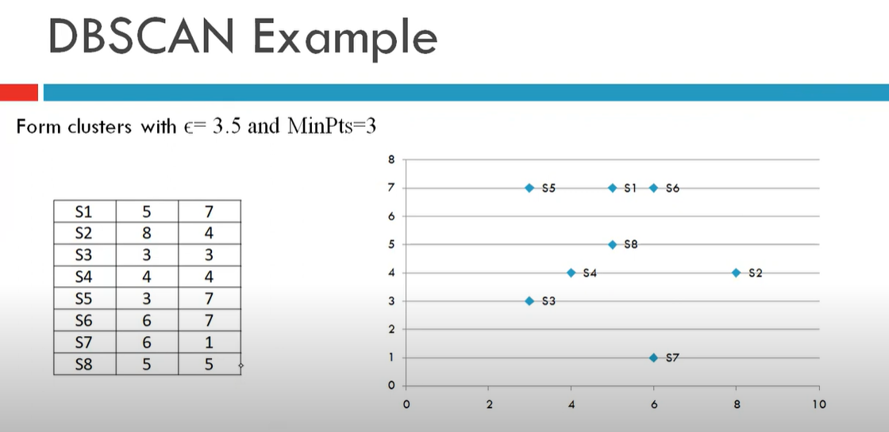

Slide 7
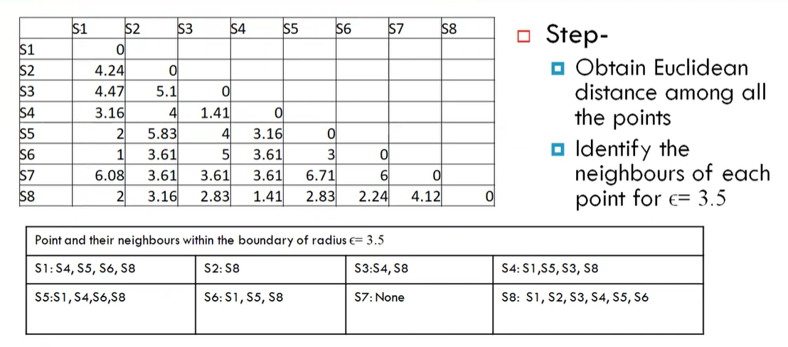

Slide 8
